Slide 1
Replication/Revision/Rejection
Conclusion
L(M|D) ∝ P(D|M) Frequentist
P(M|D) ∝ P(D|M) · P(M) Bayesian
Causal claim
Causal effects Explanations
Causal inference
Data
Model
Inference algorithm
Statistical inference Machine learning
Observations
Predictions
P(D|M)
Natural process
Causal model
DGP model
Probability theory
Inductive reasoning
Real world
Abstract world
Propositional logic Deductive reasoning
Empiricism
Rationalism
Notes:
A probability model is the triplet (Ω, σ-algebra, P)
Generative vs Discriminative

Slide 2
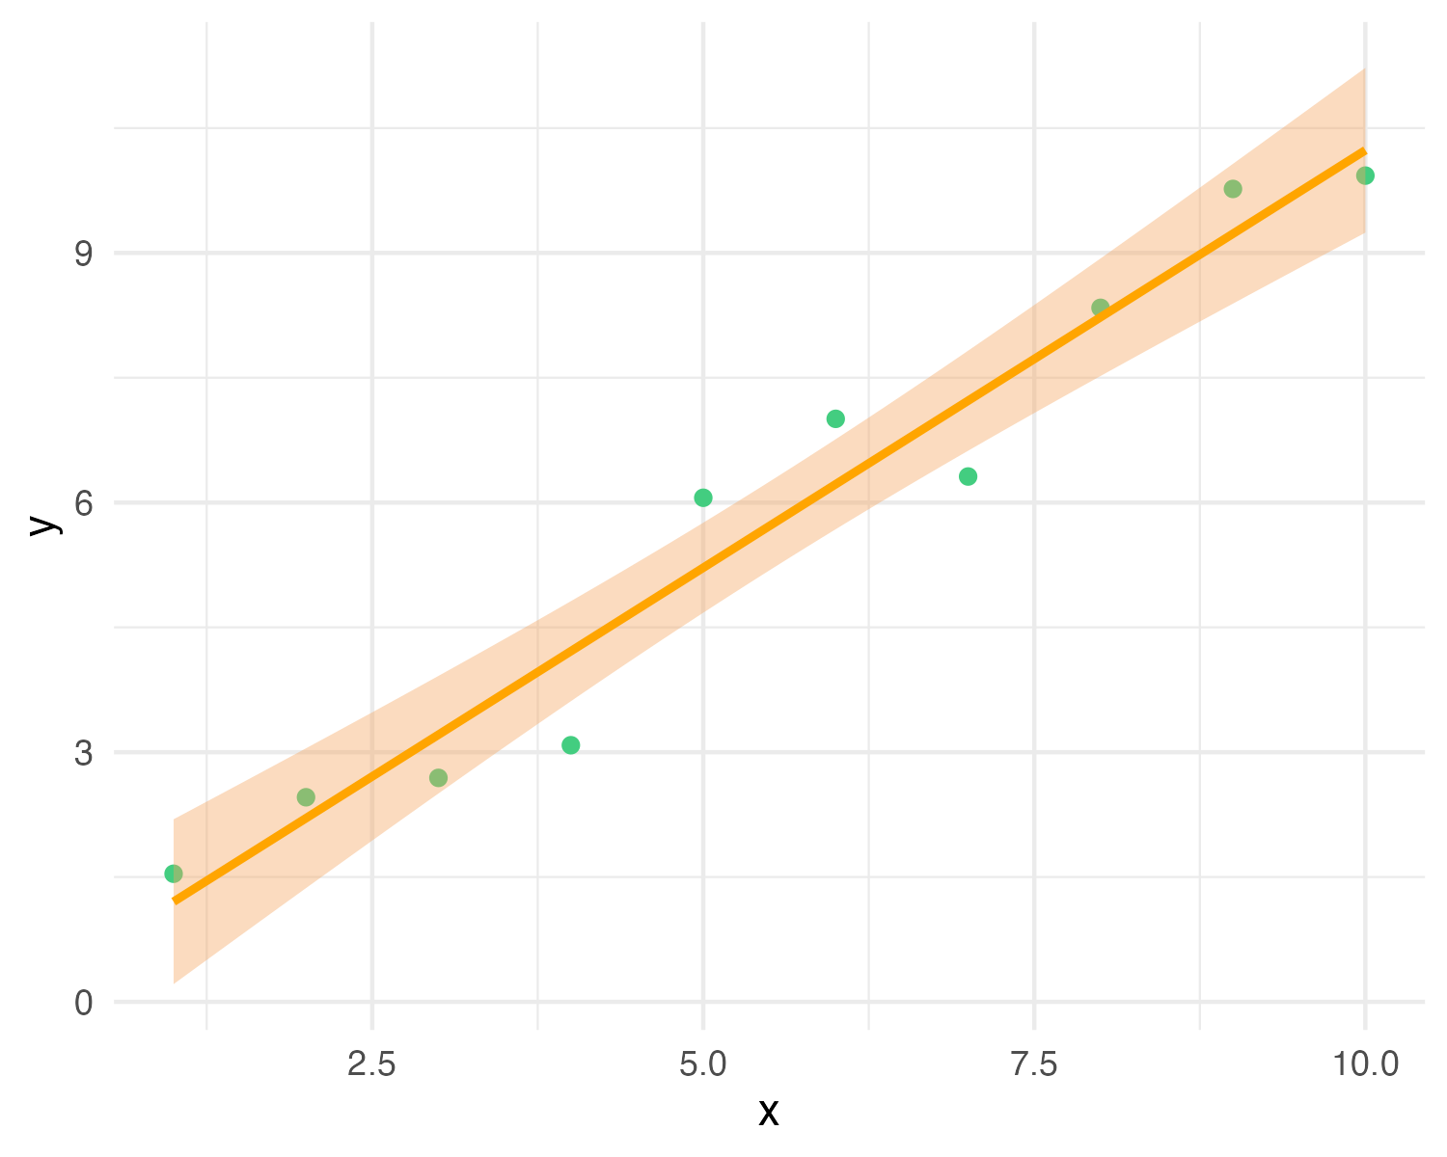
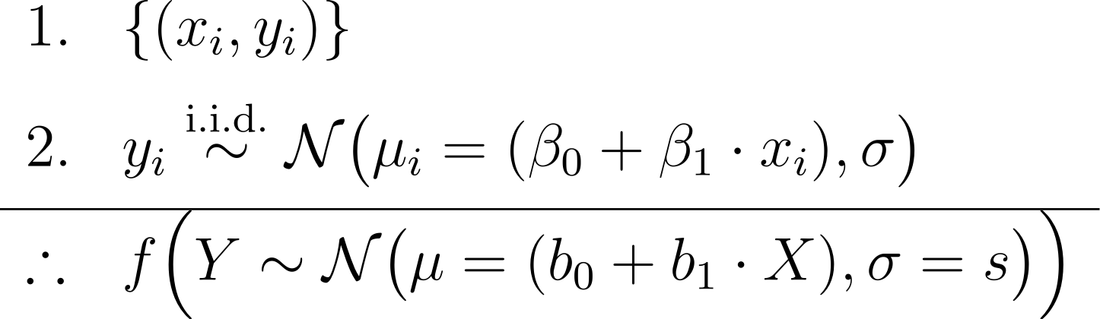
y_{i} ∼ N(μ_{i} = (β₀ + β₁ · x_{i}), σ)
premises assumptions evidence KB
premises
data
causal model
conclusion
likelihood (+ prior)
estimator
Y = b₀ + b₁X with CI
MLE (or posterior) predictive model
effect
= conclusion claim hypothesis query
Notes:
In Bayesian inference we add priors to the premises, and obtain a joint posterior distribution of the parameters conditioned on the data p(beta0, beta1, sigma | data), or a posterior predictive distribution as conclusion
In frequentist inference we obtain maximum-likelihood estimates of the parameters (b0, b1, s)
https://latex.unacademy.com/
\begin{array}{ll}
1. & \{(x_i, y_i)\} \\[6pt]
2. & y_i \stackrel{\text{i.i.d.}}{\sim} \mathcal{N}\bigl(\mu_i = (\beta_0 + \beta_1 \cdot x_i), \sigma\bigr) \\[4pt]
\hline
\therefore & f \Bigl(Y \sim \mathcal{N}\bigl(\mu = (b_0 + b_1 \cdot X), \sigma = s\bigr)\Bigr) \\
\end{array}

Slide 3
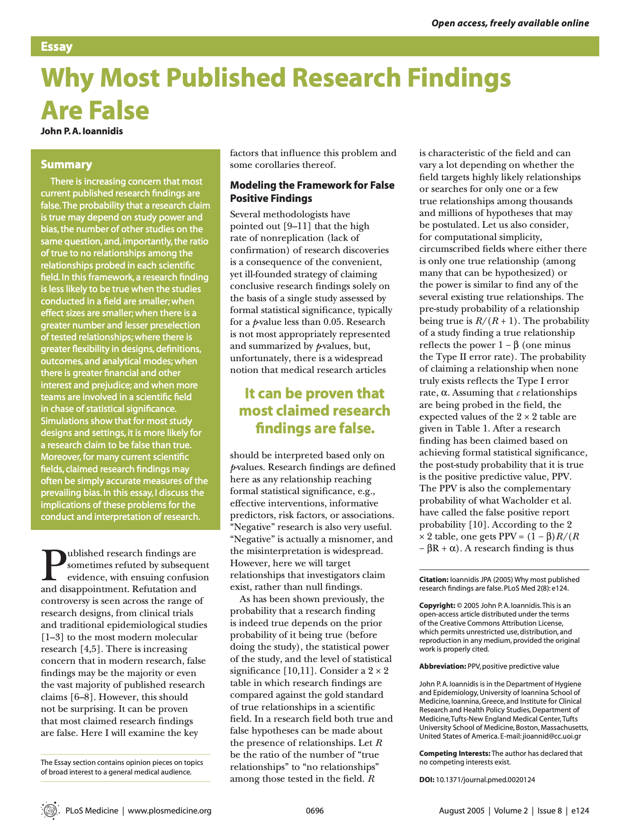
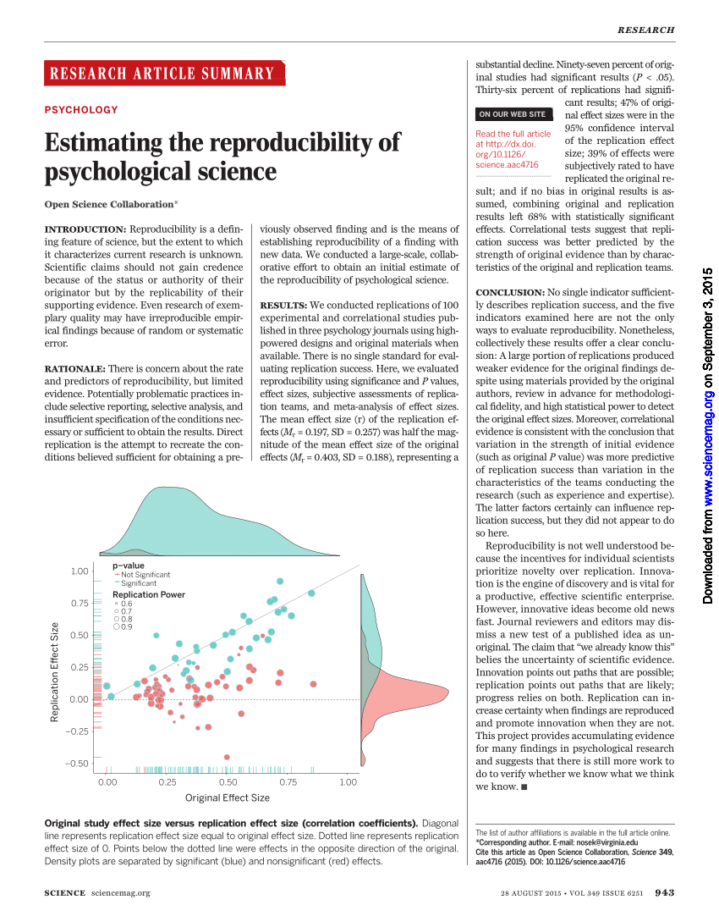

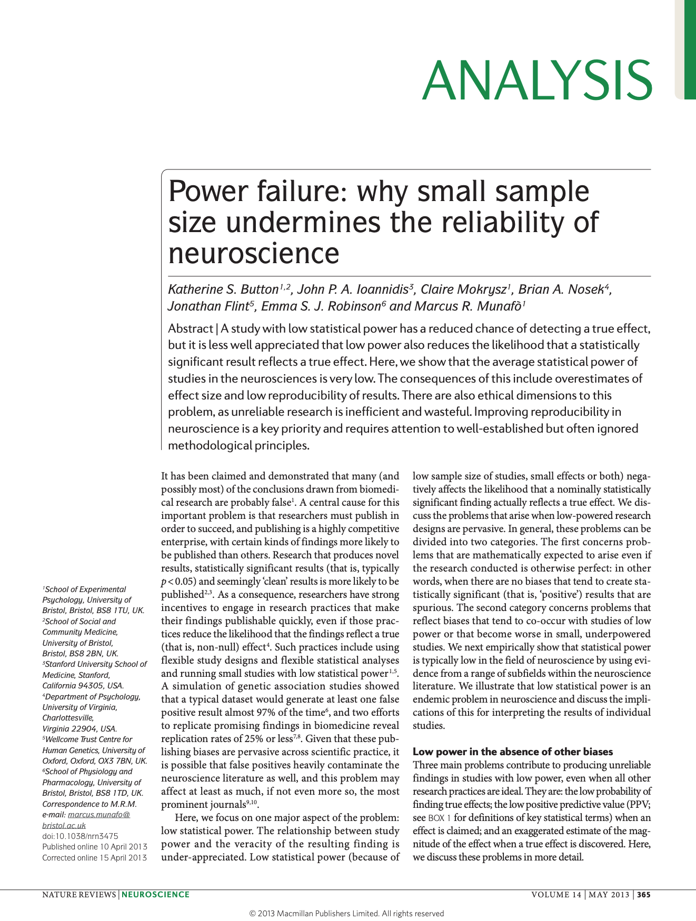

Slide 4
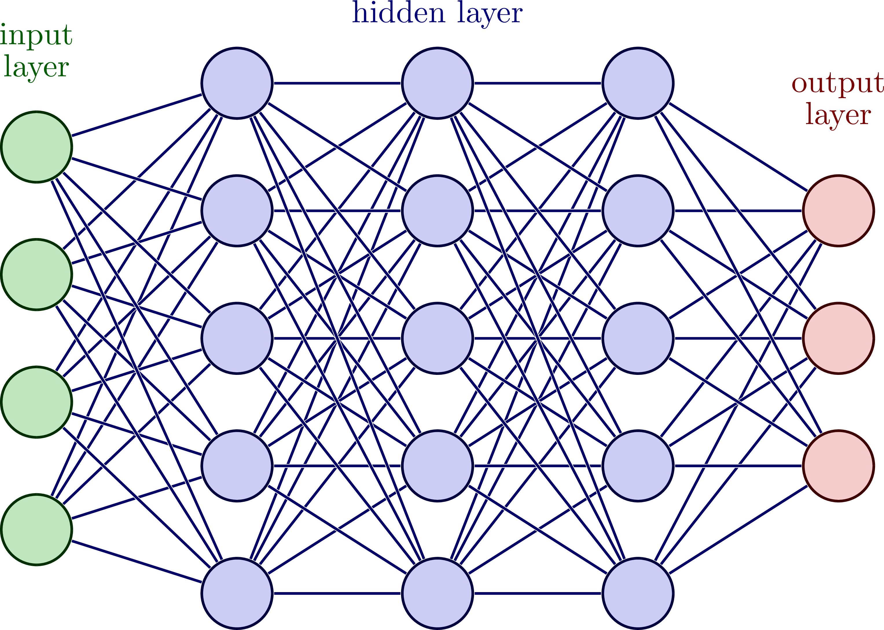
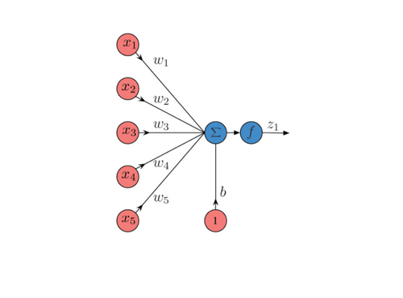
Deep neural network
Artificial neuron = GLM
b₁
b₂
b₃
b₄
b₅
b₀

Slide 5



Slide 6
